Slide 1
Unit-3
[Computer Fundamentals]
Functional Units of a Digital computer

Slide 2
Functional units of a computer system are parts of the CPU (Central Processing Unit) that performs the operations and calculations called for by the computer program.
A computer consists of five main components namely, Input unit, Central Processing Unit, Memory unit , Arithmetic & logical unit, Control unit and an Output unit.

Slide 3
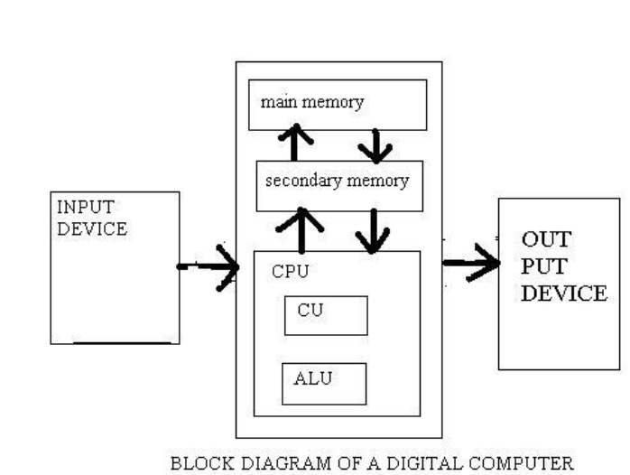

Slide 4
Input unit
Input units are used by the computer to read the data.
The most commonly used input devices are keyboards, mouse, joysticks, trackballs, microphones, etc.
However, the most well-known input device is a keyboard.
Whenever a key is pressed, the corresponding letter or digit is automatically translated into its corresponding binary code and transmitted over a cable to either the memory or the processor.

Slide 5
Central processing unit
Central processing unit commonly known as CPU can be referred as an electronic circuitry within a computer that carries out the instructions given by a computer program by performing the basic arithmetic, logical, control and input/output (I/O) operations specified by the instructions.

Slide 6
Memory unit
The Memory unit can be referred to as the storage area in which programs are kept which are running, and that contains data needed by the running programs.
The Memory unit can be categorized in two ways namely, primary memory and secondary memory.
It enables a processor to access running execution applications and services that are temporarily stored in a specific memory location.

Slide 7
Primary storage is the fastest memory that operates at electronic speeds. Primary memory contains a large number of semiconductor storage cells, capable of storing a bit of information. The word length of a computer is between 16-64 bits.
It is also known as the volatile form of memory, means when the computer is shut down, anything contained in RAM is lost.
Cache memory is also a kind of memory which is used to fetch the data very soon. They are highly coupled with the processor.
The most common examples of primary memory are RAM and ROM.
Secondary memory is used when a large amount of data and programs have to be stored for a long-term basis.
It is also known as the Non-volatile memory form of memory, means the data is stored permanently irrespective of shut down.
The most common examples of secondary memory are magnetic disks, magnetic tapes, and optical disks.

Slide 8
Arithmetic & logical unit
Most of all the arithmetic and logical operations of a computer are executed in the ALU (Arithmetic and Logical Unit) of the processor.
It performs arithmetic operations like addition, subtraction, multiplication, division and also the logical operations like AND, OR, NOT operations.

Slide 9
Control unit
The control unit is a component of a computer's central processing unit that coordinates the operation of the processor.
It tells the computer's memory, arithmetic/logic unit and input and output devices how to respond to a program's instructions.
The control unit is also known as the nerve center of a computer system. It manages and coordinates the execution of instructions.
Let's us consider an example of addition of two operands by the instruction given as Add LOCA, RO.
This instruction adds the memory location LOCA to the operand in the register RO and places the sum in the register RO.
  Instruction fetch
  Instruction Decode
  Operand fetch
  Execution
  Memory Access
  I/O Management

Slide 10
Output Unit
The primary function of the output unit is to send the processed results to the user. Output devices display information in a way that the user can understand.
Output devices are pieces of equipment that are used to generate information or any other response processed by the computer. These devices display information that has been held or generated within a computer.

Slide 11
Von Neumann Architecture
Computer is built on John von Neumann’s concept of stored programmes.
Programs and data are kept in a distinct storage unit called memories in this stored-program approach, and they handle the same.
A computer developed with this design would be considerably easier to reprogram

Slide 12
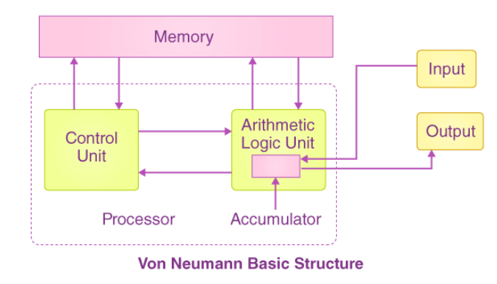

Slide 13
It’s made up of three fundamental components:
  The CPU or Central Processing Unit
  The Main Memory Unit (most important part of the system)
  The I/O Device or the Input/Output Device

Slide 14
CPU (Central Processing Unit)
The control unit, main memory, and arithmetic-logic unit make up the central processing unit (CPU), which is the most important portion of any digital computer system.
The CPU is the computer’s brain, including all of the circuitry required to process input, store data, and generate output.
The CPU is always following computer program instructions that instruct it on which information to process as well as how to process it.
We couldn’t run applications on a computer without a CPU.

Slide 15
CU (Control Unit) &ALU
It is responsible for all processor control signals.
It governs how data moves throughout the system, directs all input and output flow, and gets code for instructions.
ALU (Arithmetic and Logic Unit)
The arithmetic logic unit (ALU) is the portion of the CPU that handles all of the CPU’s computations, such as addition, subtraction, and comparisons.
Also, Logical operations, arithmetic operations, and bit shifting operations are all performed by it.

Slide 16
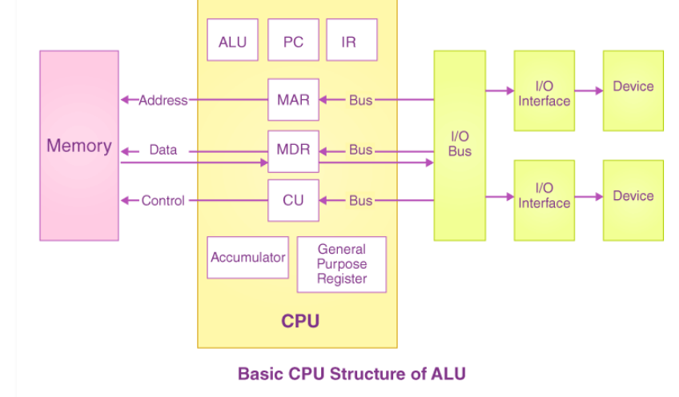

Slide 17
Registers (Main Memory Unit)
Registers are a sort of computer memory that is used to accept, store, and transport data and instructions that are used by the CPU right away.
Processor registers is the term used to define the registers that the CPU uses.
Registers are highly fast computer memory that are used to efficiently execute programs and operations in computer architecture.

Slide 18
Accumulator: It stores the results of the calculations that the ALU makes.
Program Counter: The PC keeps track of the location of the memory of the next instructions that are to be dealt with. Then this next address is passed by the PC and passes to the Memory Address Register (MAR).
Memory Address Register: MAR stores the memory locations of those instructions that are either to be fetched from the memory or to be stored in the memory.
Memory Data Register: MDR stores the data that are fetched from the memory or any information that is to be transferred to and stored in the memory.
Current Instruction Register: CIR stores the recently fetched instructions while it waits for coding and execution.
Instruction Buffer Register: (Buffer-no need to wait for the instruction)The instruction that isn’t to be immediately executed is placed in the IBR or instruction buffer register.

Slide 19
I/O Devices
Under the control of CPU input instructions, the programme or the data is read into the main memory from the secondary storage or the input device. The data from a computer is output using output devices. If any results are evaluated by a computer and saved in it, you can present them to a user via output devices.
Buses
Data is sent from one portion of a computer to another via buses, which connect all key internal components to the memory and CPU. They are of the following types:
Control Bus: It receives control commands from the CPU, as well as status signals from other devices, and uses them to control and coordinate all of the computer’s actions. (clock signal,read/write signal)
Address Bus: It carries memory address from CPU to memory and other peripherals
Data Bus: It carries data between CPU to memory and other peripherals

Slide 20
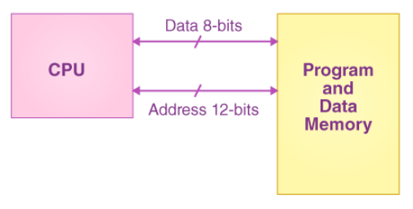

Slide 21
Memory Unit
A memory unit is a collection of storage cells together with associated circuits needed to transfer information in and out of the storage.
The memory stores binary information in groups of bits called words. The internal structure of a memory unit is specified by the number of words it contains and the number of bits in each word.
Two major types of memories are used in computer systems:
1. RAM (Random Access Memory)
2. ROM (Read-Only Memory)

Slide 22
Instruction Format
Rectangular box – bits of the instruction (memory word/control register)
Defines – layout of the bits of an instruction – constituent parts
Bits of instruction – groups called fields
Most common field – IF
  Operation code- specifies the operation
  Address field- memory address or processor register
  Mode field-specifies the way the operand / address is determined

Slide 23
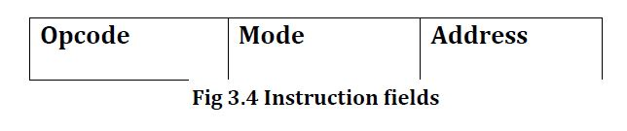
Operation code: Add, subtract, complement, shift
Address field: Memory address/register address
Mode field: Ways in which operand is chosen

Slide 24
Types of Instruction Format
Three address instructions
Two address instructions
One address instructions
Zero address instructions
Each Address field used to specify
-> Process Register ->Memory Operand

Slide 25
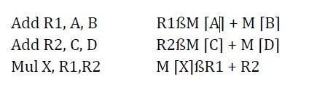
Three Address Instruction
Program in Assembly Language
Process Registers – R1 and R2
M[A] – Operand at Memory Addr symbolized by A
Adv – short programs – arithmetic expressions
Disadv – Binary coded instruction – too many bits
Eg: Cyber 170

Slide 26
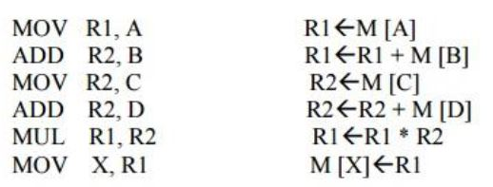
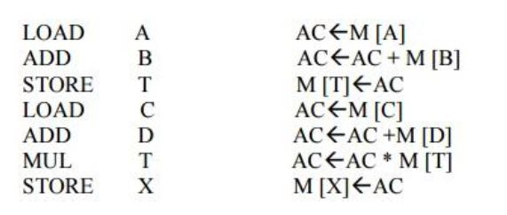
Two Address Instruction
Most Common in Commercial Computers
One Address Instruction
AC – Accumulator register
T – Addr of a temporary
memory location

Slide 27
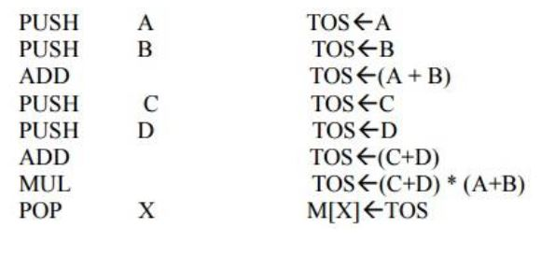
Zero Address Instruction
Stack organized computer – No usage of address field (ADD and MUL)
Zero Address – Absence of an address field

Slide 28
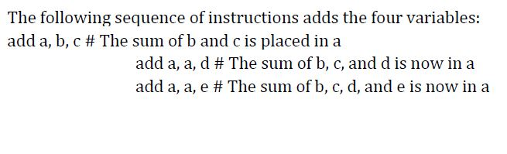
Operations and Operands

Slide 29
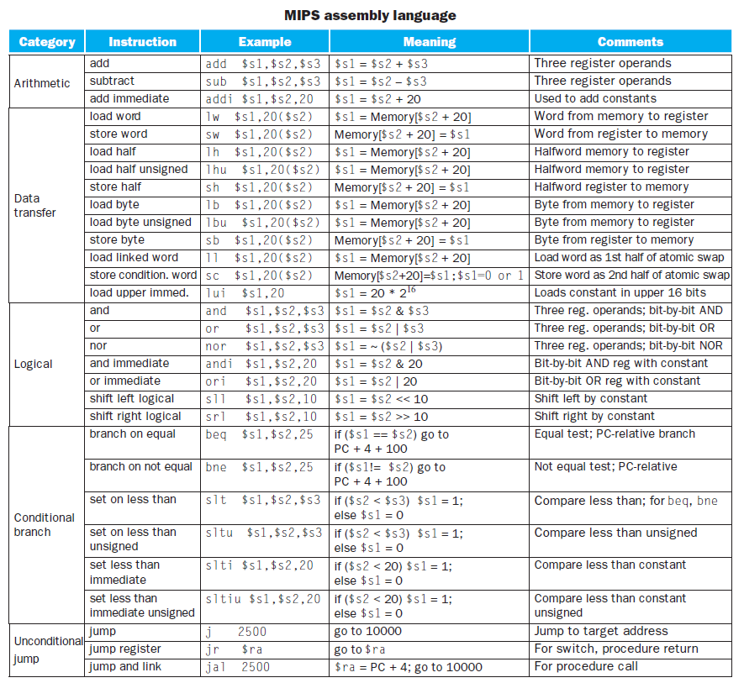
MIPS Instructions

Slide 30
Types of Operations
Arithmetic
Data Transfer
Logical
Conditional Branch
Unconditional Jump

Slide 31
Arithmetic
Instructions:
add, subtract, add immediate
add $s1, $s2, $s3 subtract $s1, $s2, $s3
$s1 = $s2 + $s3 ➔ $s1 = $s2 - $s3
add i $s1, $s2, $s3
➔ $s1 = $s2 + 50

Slide 32
Data Transfer
Instructions: load word, store word, load half, store half, load byte, store byte,
load linked words, store condition word, load upper immediate
lw $s1, 50($s2)➔word from memory to register
sw $s1, 50($s2)➔word from register to memory

Slide 33
lh $s1, 50($s2) ➔ Half word memory to register
sh $s1, 50($s2) ➔ Half word register to memory
lb $s1, 50($s2) ➔ Byte from memory to register
sb $s1, 50($s2) ➔ Byte from register to memory
lui $s1, 50 ➔ load constant in upper 16 bits

Slide 34
Logical Operations
Instructions: and, or, nor, shift left logical, shift right logical
and $s1, $s2, $s3 ➔ Bit by bit and
or $s1, $s2, $s3 ➔ Bit by bit or
nor $s1, $s2, $s3 ➔ Bit by bit nor
sll $s1, $s2, 10 ➔shift left by constant
srl $s1, $s2, 10 ➔shift right by constant

Slide 35
Conditional Branch
Instructions: branch if equal, branch if not equal, branch if greater than, branch if less than, branch….
beq $t1, $t2, next(compares t1 and t2, stores in next)
bne $t1, $t2, else
bgt $t1, $t2, top
blt $t1, $t2, two
b loop

Slide 36
Unconditional Jump
Instructions: jump, jump register
Jump to target address➔j 500
jr $ra
(for, switch,procedure)

Slide 37
ISA

Slide 38
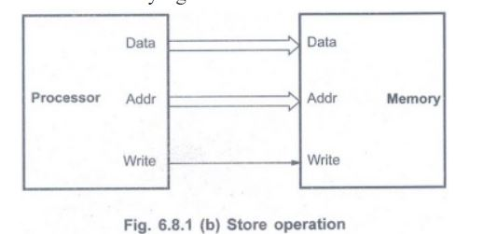
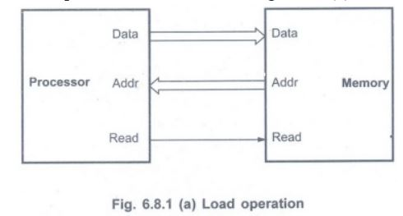
Memory Operations
Memory ( Program Instructions + Data Operands )

Slide 39
Instructions and Instruction Sequencing
Data transfer between memory and process register
Arithmetic and logic operation on data
Program sequencing and control
I/O control

Slide 40
Register Transfer Notation
R2 <- [Loc] ===== contents of memory location are transferred into processor register
R3 <- [R1] + [R2]
Contents of processor registers R1 and R2 are added and the result is stored into the processor register

Slide 41
Assembly Language Notations
MOVE R2, R1
Contents of processor register R2 are transferred to processor register R1
R2 - Unchanged
R1 - Overwritten

Slide 42
ADD R1, R2, R3
Contents of processor register R1 and R2 are added and transferred to R3
Three address instruction
ADD A, B, C
Operation, Source 1, Source 2, Destination

Slide 43
Two Address Instruction
ADD A, B
Operation, Source 1, Destination
One Address Instruction
ADD B
Operation Source

Slide 44
Instruction Sequencing
To perform a particular task – write instructions in a proper sequence
Execution done with the help of Program Counter
Program Counter holds the address of the instruction to be executed next

